Slide 1
HIT LEVEL DATA - Adobe Case Study (Data Engineer Role)
- Kousalya Lakshmanan

Slide 2
Adobe Case Study - Data Engineer Role
Project Goal
Dataset: Tab separated file which contains the “hit level data”. Single hit from a visitor on the client’s side generates a record. Based on the client’s implementation, several variables can be set and sent to Adobe Analytics for deeper analysis.
Business Use Case: To analyze the hit level data and to write a Python application that is capable of reading this data file and portray the revenue the client is getting from external Search Engines & which keywords perform the best based on the revenue, in AWS.
Business Outcome: A TAB file which contains the Search Engine Domain, Search Keyword & Revenue data generated in a S3 bucket whenever the AWS Lambda function is invoked.

Slide 3
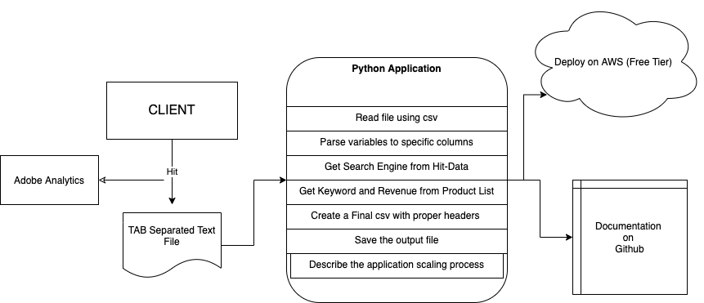
Adobe Case Study - Data Engineer Role
Flow Chart

Slide 4
Adobe Case Study - Data Engineer Role
Tech Stack
Python 3.9
Aws Lambda, S3

Slide 5
Adobe Case Study - Data Engineer Role
Development Requirements
Create a Python application that needs to be deployed and executed within AWS
The Python application needs to contain at least one class.
The Python application needs to accept a single argument, which is the file that needs to be processed.

Slide 6
Adobe Case Study - Data Engineer Role
Execution Process
Zipping all the files from the local repository to AWS S3 Bucket
Deploying the scripts in AWS Lambda
Testing the use cases
Finally, A TAB file is been generated within the same S3 Bucket which contains Search Engine Domain, Search Keyword & Revenue column data.

Slide 7
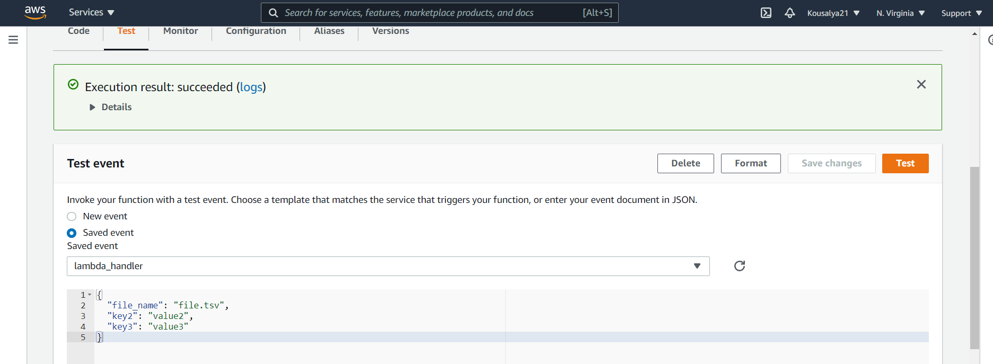
Adobe Case Study - Data Engineer Role
Log Output

Slide 8
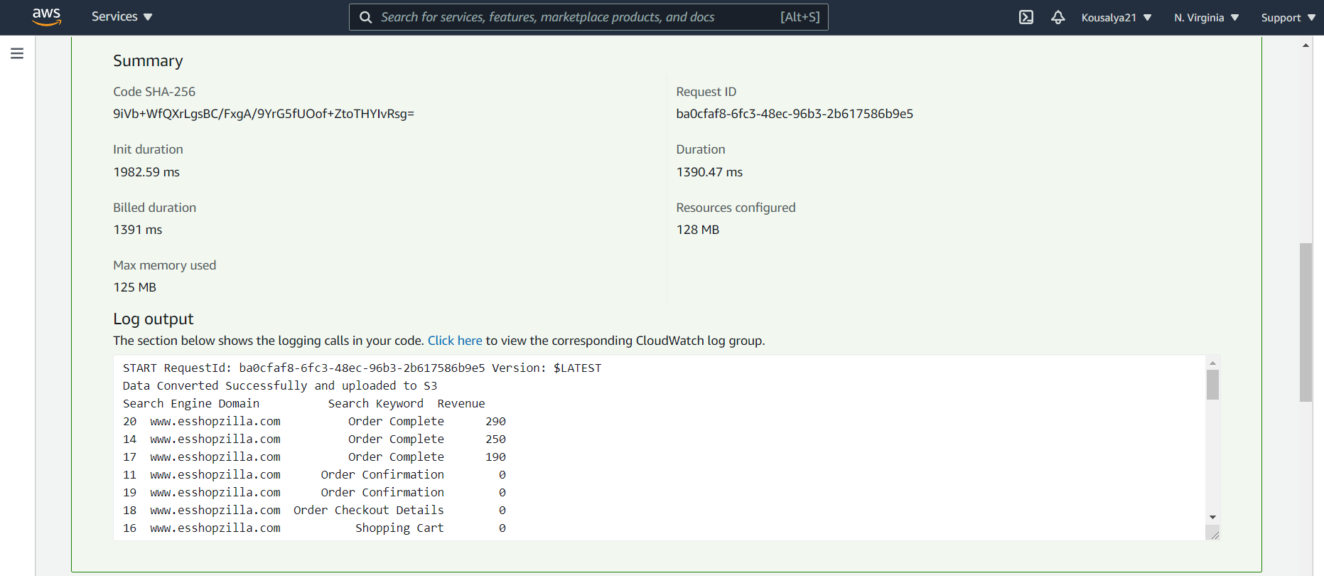
Adobe Case Study - Data Engineer Role
Log Output

Slide 9
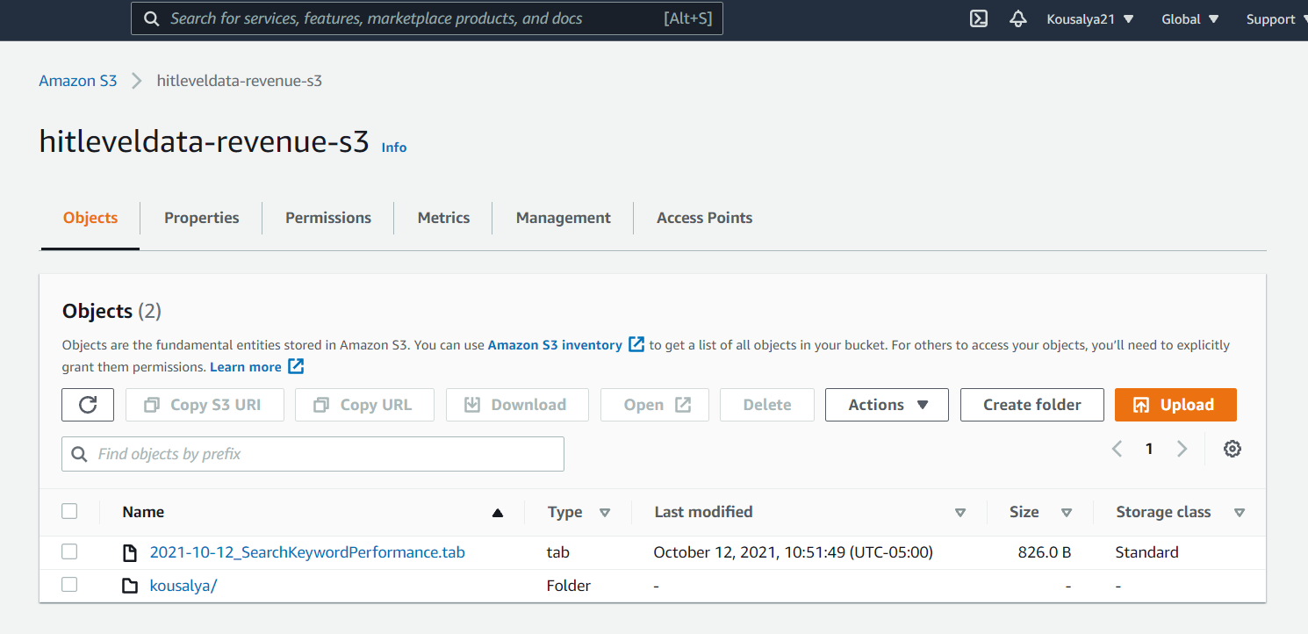
Adobe Case Study - Data Engineer Role
Log Output

Slide 10
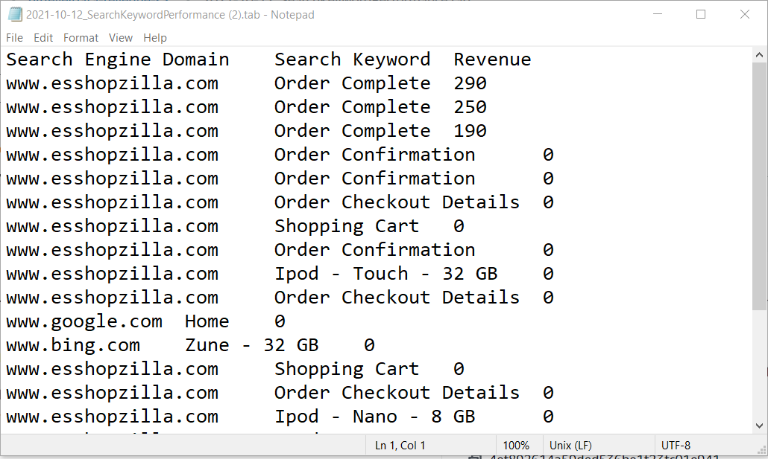
Adobe Case Study - Data Engineer Role
Log Output

Slide 11
Adobe Case Study - Data Engineer Role
GitHub Link
https://github.com/Kousalya21/Hit-Level-Data

Slide 12
Thank You!

